Slide 1
LSU/OLOL Neurotology Fellowship
Fellowship Candidate Visit
July 2022 Start Date

Slide 2
Overview
ACGME Initial Accreditation – 2013
1 Fellow per 2-year Cycle
Fellowship Graduates
Isaac Erbele, MD – 2018-2020; Maj, US Army, currently practicing at San Antonio Military Medical Center
Gauri Mankekar, MD, PhD – Neurotology/Skull Base Fellowship 2017-2019; faculty at LSUHSC-Shreveport (non-ACGME)
Joshua Sappington, MD – 2015-2017; faculty member at St. Louis University
Sam Spear, MD – 2013-2015; Lt Col, USAF, currently practicing at San Antonio Military Medical Center
Rahul Mehta, MD – Advanced Otology/Rhinology (1 year) 2014; LSU Otolaryngology faculty (non-ACGME)

Slide 3
The LSU Neurotology-
Skull Base Fellowship
Comprehensive skull base experience
Full spectrum of otology/neurotology
Significant experience with:
Rhinologic endoscopic & transfacial skull base approaches
Craniofacial techniques
Neurosurgical aspects of care
Neuroradiology, skull base histopathology
Skull base reconstruction

Slide 4
Program Sites
LSU New Orleans
Sponsoring Institution
LSU Otolaryngology Residency with 19 residents in PGY1-PGY5
Our Lady of the Lake Regional Medical Center
Primary Training Site
Additional sites:
West Jefferson Medical Center
Children’s Hospital New Orleans
University Medical Center New Orleans
Our Lady of the Lake Children’s Hospital – opened in October 2019

Slide 5
Neurotology Core Faculty
Moises A. Arriaga, MD
Fellowship Program Director
Neurotology
Laura Hetzler, MD
Residency Director
Facial plastic surgery
Facial reanimation
Daniel Nuss, MD
Chairman
Endoscopic skull base surgery
Anne Maxwell, MD
Joined faculty summer 2020
Clinical Assistant Professor
Additional Program Faculty
Frank Culicchia, MD
Neurosurgery Chairman
West Jefferson cases
Kelly Scrantz, MD
Neurosurgery NMC
Baton Rouge cases
Rahul Mehta, MD
Advanced Otology/Rhinology/Skull Base Surgery

Slide 6
LSU ENT Clinical Faculty
Lacey Adkins, MD
Phillip Allen, MD
Moises Arriaga, MD
Bradley Chastant, MD
Jill D’Souza, MD
Michael Dunham, MD
Adele Evans, MD
Andrew Fuson, MD
Celeste Gary, MD
Nathan Grohmann, MD
Michael Hagmann, MD
Stephen Hernandez, MD
Joel Jones, MD
Kevin McLaughlin, MD
Belinda Mantle, MD
Ashley Mays, MD
Andrew McWhorter, MD
Robert Peden, MD
Laura Pelaez, MD
Mark Petitjean, MD
Justin Sowder, MD
Larissa Sweeny, MD
Jairo Torres, MD
James Walker, MD
Rohan Walvekar, MD

Slide 7
Fellowship Philosophy
Neurotology clinical training: Excellence in all aspects of surgical and office neurotology as outlined by the ACGME
Anterior Endoscopic Skull Base training: Skills in true three-dimensional tumor management
Robust research opportunities: Clinical, basic and translational science related to neurotology

Slide 8
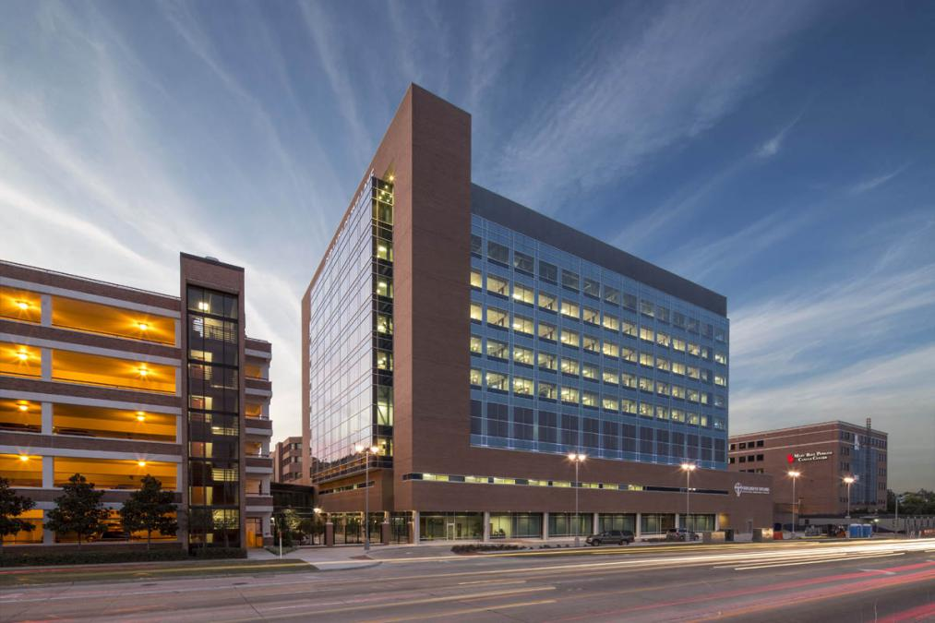
Our Lady of the Lake
Regional Medical Center
Baton Rouge
South Louisiana’s major academic hospital
OLOL Pediatrics Residency
5 LSU residencies (EM, IM, surgery, psychiatry, ENT) rotate here as well as OMFS and several outside programs
Schools of Nursing, PA, Resp. Therapy, Rad Tech, PT Assist
Over 700 beds
Largest hospital in Louisiana
LSU Voice Center, OLOL/Mary Bird Perkins Head and Neck Center
* Gamma Knife Icon
Extensive commitment to education
Freestanding OLOL Children’s Hospital opened in October 2019

Slide 9
Clinical Resources – Baton Rouge
OLOL Hearing and Balance Center
Adult and Pediatric Neurotology – Skull Base
Active Vestibular Team
6 Audiologists and 2 Vestibular Physical Therapists
Facial Rehabilitation Team
Adult and Pediatric CI Center
OLOL Head and Neck Center – Oncology and Anterior Skull Base Surgery
Gamma Knife ICON
NeuroMedical Center Partnership
Fellow Activities: Clinic, OR, and most conferences

Slide 10
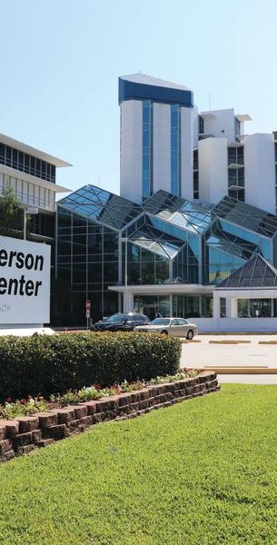
West Jefferson Medical Center
New Orleans
Adult Neurotology – Skull Base
Active Vestibular Team
3 Audiologists and 2 Vestibular Physical therapists
Part of Neurosurgery / Neurology Group
Adult CI Center
Pediatric CI through Children’s Hospital New Orleans
Close collaboration with LSU Neurosurgery; Anterior Skull Base Surgery with Dr. Nuss
Cyberknife
Fellow Activities
OR , Neurosurgery Rotation, Cyberknife Rotation

Slide 11
Research Resources
Basic Science collaborators
Jennifer Lentz, PhD, Hamilton Farris, PhD
School of Allied Health
Anatomic Collaboration
Center for Advanced Practice
Clinical Studies
Prospective (Otonomy, Balloon), Retrospective Clinical
Fellowship Specifics
PhD Research Coordinator
PhD Research Audiologist
Funding for Statistician
Research Rotation or Research Time
MD Fellowship Coordinator

Slide 12
Fellow Research
Presentations/Publications
  SCD v Thin Bone Over the Superior Semicircular Canal (Torok Award –ANS)
  SCD in Pediatrics – AOS
  Temporal Bone Encephalocele Repair – NASBS
  EAC Carcinoma with parotid and facial nerve involvement – NASBS
  Skull Base Adenocystic CA – NASBS
  CI and Cautery
  CI Trajectory
  CI Electrode Length and Long-term Hearing Preservation
  MRI Prediction in DSC
  Encephalocele Repair Technique
  MRI Techniques in Acoustic Neuroma

Slide 13
Fellow Research
Presentations/Publications (continued)
  Pediatric Skull Base Tumors
  Unusual Temporal Bone Carcinoma
  CSF Leak Prevention in AN
  Hydroxyapatite Cement Removal
  Hearing Preservation in AN
  Haste Imaging Pitfalls
  Carotid Resection in SBS
  Muscle-Nerve-Muscle Grafting for Facial Reanimation in Rats
  Ultrasonic Bone Aspirator in Endoscopic Ear Surgery
  Endoscopic Carotid Occlusion for ICA Resection
  Transcanal Endoscopic Tympanoplasty

Slide 14
Fellow Research
Presentations/Publications (continued)
  Technical Challenges in Cochlear Implantation: ANS Neurotology Fellows Video Competition
  Endoscopic Inside-Out Mastoidectomy with the Ultrasonic Bone Aspirator
  Cochlear Implantation via Middle Fossa Approach – Case Report
  Cochlear Implantation in the CSF Gusher Syndrome
  Intracranial Rosai-Dorfman Disease – NASBS
  Challenges for Cochlear Implantation Following Lateral Skull Base Encephalocele Repair: Case Studies – NASBS
  Do Central Vestibular Findings Predict Abnormal Findings on Magnetic Resonance Imaging?

Slide 15
Fellow Research
Presentations/Publications (continued)
  “Orbitorhinocerebral Syndrome” chapter in Fungal Infections of the Central Nervous System
  Endoscopic over under cartilage tympanoplasty is not inferior to underlay cartilage tympanoplasty – World Endoscopy Congress
  Malignant hyperthermia during translabyrinthine acoustic neuroma surgery after previous uneventful surgery
  Cochlear enhancement may precede cochlear obliteration after vestibular Schwannoma excision – COSM 2019

Slide 16
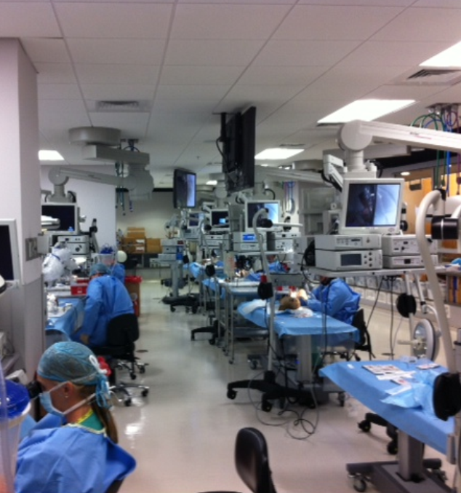
LSU Temporal Bone Dissection Course
Three Annual Courses with National Faculty

Slide 17
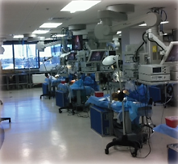
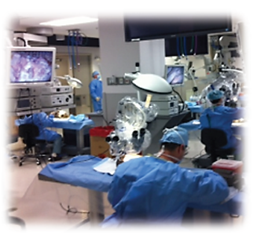
The Russell Klein, MD Center for Advanced Practice

Slide 18
Fellow Operative Experience 2013-2020
(Average per Fellow over 2 Years)
Procedure | Average Number of Cases* | Case Log Minimums
Approaches for Skull Base Surgery | 109 | 25
Resection of Neurotologic Tumors | 56 | 20
Temporal Bone Resection | 5 | 2
Reconstruction after Resection of Neurotologic Tumors | 51 | 15
Vestibular Surgery | 30 | 10
Rehabilitative Surgery | 76 | 20
Total Procedures | 310 | 0
Paraganglioma Tumor | 4 | 2
Vestibular Schwannoma | 52 | 20
Facial Nerve Tumor | 4 | 2
Vestibular Disease | 31 | 15
Total Diagnoses | 84 | 0
*as Fellow Surgeon or Fellow Supervisor

Slide 19
Rotations/Schedule
Daily Schedule
Monday
AM Clinic OLOL or Surgery Vista (LSU Health BR) or surgery Children’s NO
Tuesday
AM/PM Surgery OLOL
Wednesday
OLOL Clinic or Endoscopic Surgery
Thursday
WJMC Surgery
Friday
Research / Surgery / Clinic

Slide 20
Rotations/Schedule
Off-Service Rotations
One- or two-week rotations:
Neurology – NeuroMedical Center Baton Rouge
Radiation Therapy –
Cyberknife WJMC
Gamma Icon – OLOL-MBP (acquired October 2016)
Neuroradiology – OLOL – Baton Rouge
Neuro-ophthalmology – New Orleans or LSUBR
Audiology/Electrophysiology – OLOL – BR
Physical Therapy – Vestibular/Facial – OLOL – BR
One-month rotation:
Neurosurgery – WJMC New Orleans

Slide 21
Rotations/Schedule
Didactics
Textbook Review – Weekly
Otolaryngology Didactic Day – Monthly
Journal Club – Quarterly
Multidisciplinary – Neurology/Neurosurgery/PT/Radiology – Weekly at NeuroMedical Center
Neuroradiology – Monthly
Otopathology – Quarterly
Otology Lectures for Residents – Monthly
Cochlear Implant Conference – q2 months
Vestibular Conference – q2 months

Slide 22
Rotations/Schedule
Responsibilities
Call - Service
Telephone call primary
Back up residents
Resident/Fellow Interactions
Otology:
Residents primary OLOL (Two Rooms Tuesday)
Fellow primary WJMC
Resident case coverage Vista
Neurotology – Fellows primary
Neurosurgery residents located only at WJMC - Collaborative

Slide 23
LSU Otolaryngology Overview
70% Otolaryngologists in Louisiana
3-City Residency Program
2-City Fellowship
Post-Katrina Evolution

Slide 24
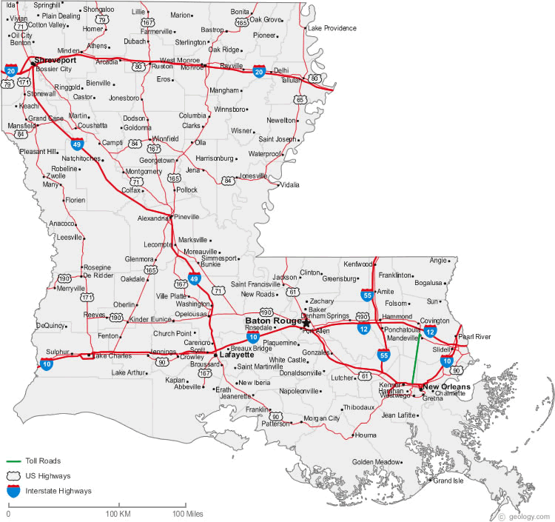



Slide 25
Practical matters – this is a regional fellowship
Fellow lives in Baton Rouge
A studio apartment is provided in New Orleans at no cost to the fellow

Slide 26
Summary
Comprehensive Training
        Clinical, surgical, all aspects
Integrated into larger Head and Neck/SBS program
Key clinical responsibilities
Abundant research opportunities
Progressive responsibility in OR and patient care

